Slide 1


Slide 2



About Company
We are Website and Mobile Application Development company in India. We provide all website solutions and digital marketing services. We leverage the technology and deep dive into the domain to figure out the simplest way to enable the sustainable growth of a business.
Our Mission
“To make the identity of each individual with affordable web,mobile and digital marketing service.”
PM MODI’S VISION:
Our Vision
Make In India
Promote Vocal for Local
Online e-shop
Empower digital India
Connect industries with technology
Promote Digital payment
“To grow each Indian in Business with the help of the digital world as per own interest.”
Our Values
Quality of our service and satisfaction of our customers is our first priority.
ATMANIRBHAR BHARAT ABHIYAN
www.renowiztech.com
+91 9737378824
info@renowiztech.com

Slide 3






What We Do
Logo & Brochure
Design
Web Design
We design a unique website for your company to convert visitors into customers.
Logo Design
Brochure Design
Business Card Design
Stationary Design
Web Development
SEO
Business Websites
Robust ecommerce store
Feature-Rich Web Application
Our SEO service for websites includes latest SEO techniques customized to your business requirements.
Digital Marketing
Explainer Video
Make your product or services Explainer video with introduction, story
and product flow.
SEO
SMM
PPC
www.renowiztech.com
+91 9737378824
info@renowiztech.com

Slide 4
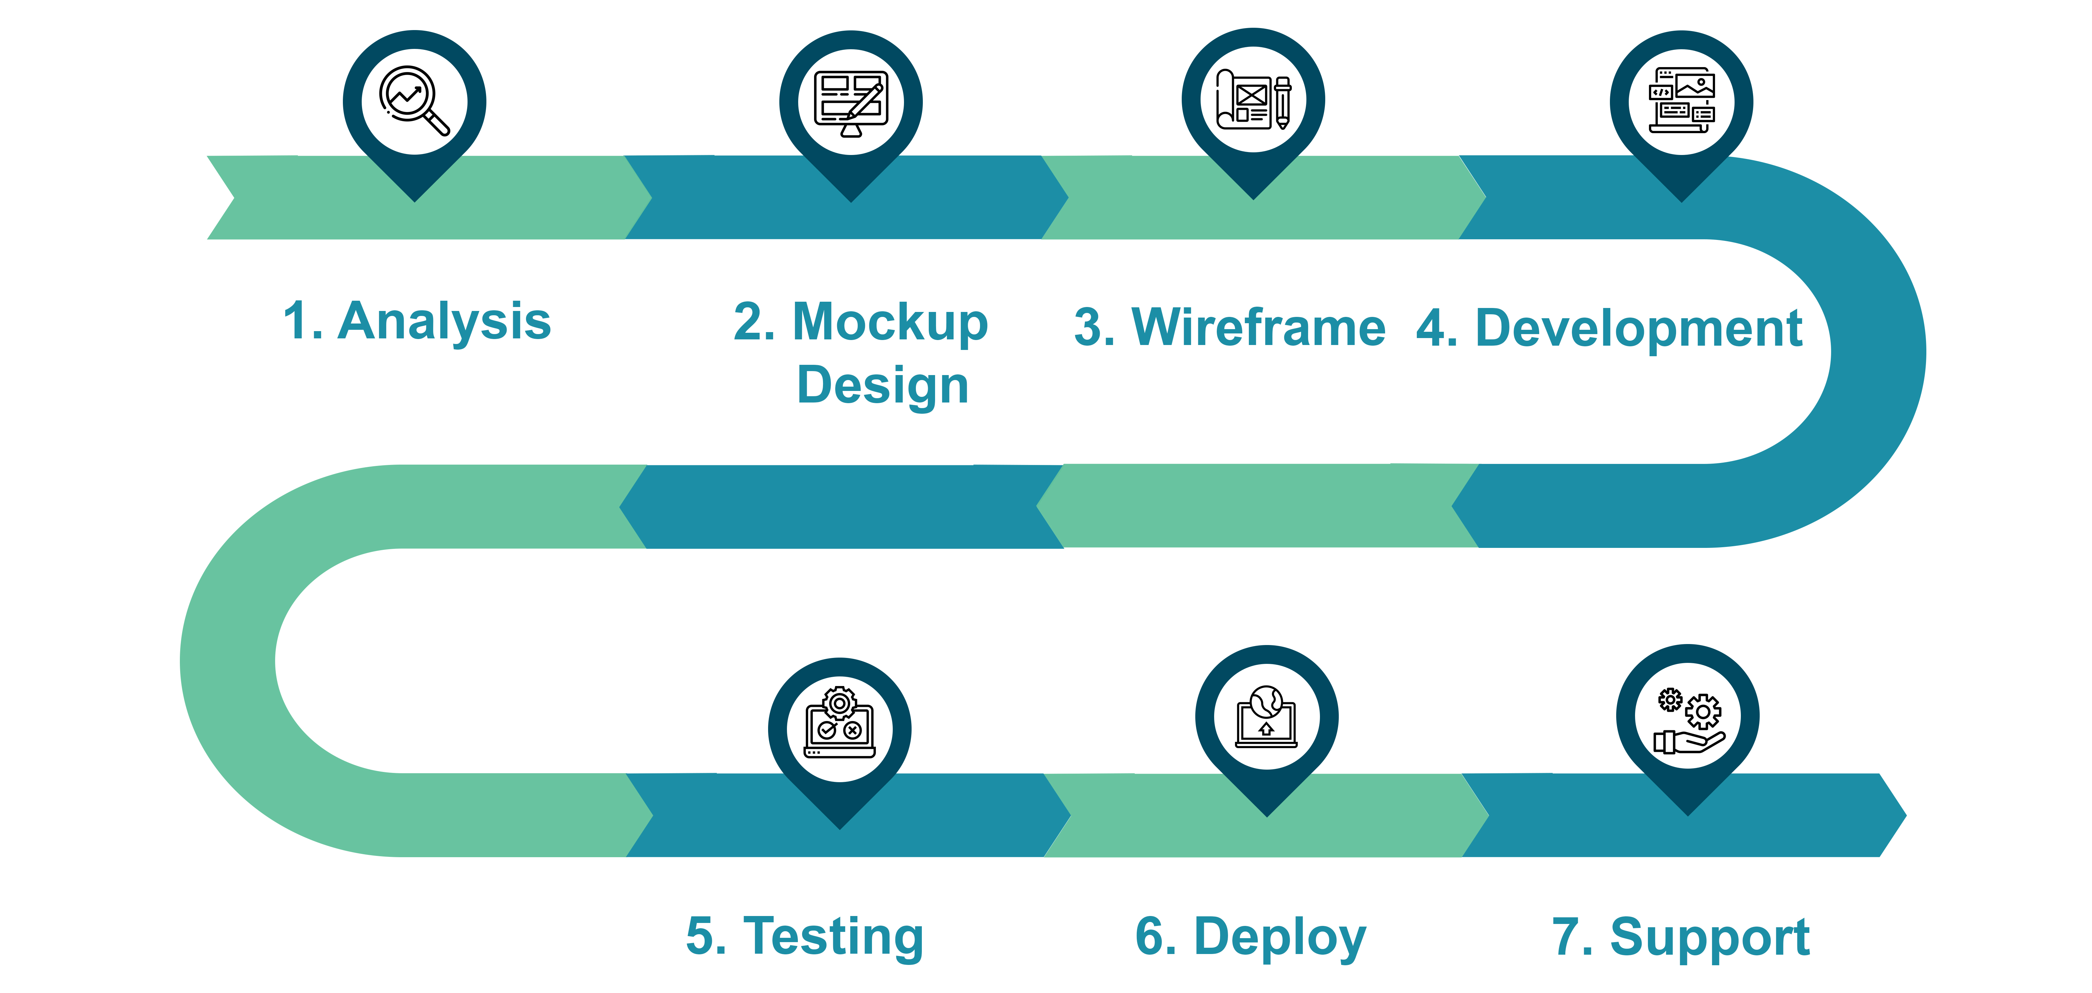
Our Process
www.renowiztech.com
+91 9737378824
info@renowiztech.com

Slide 5






Our Portfolio
Logo
Website Portfolio>>
www.renowiztech.com
+91 9737378824
info@renowiztech.com

Slide 6
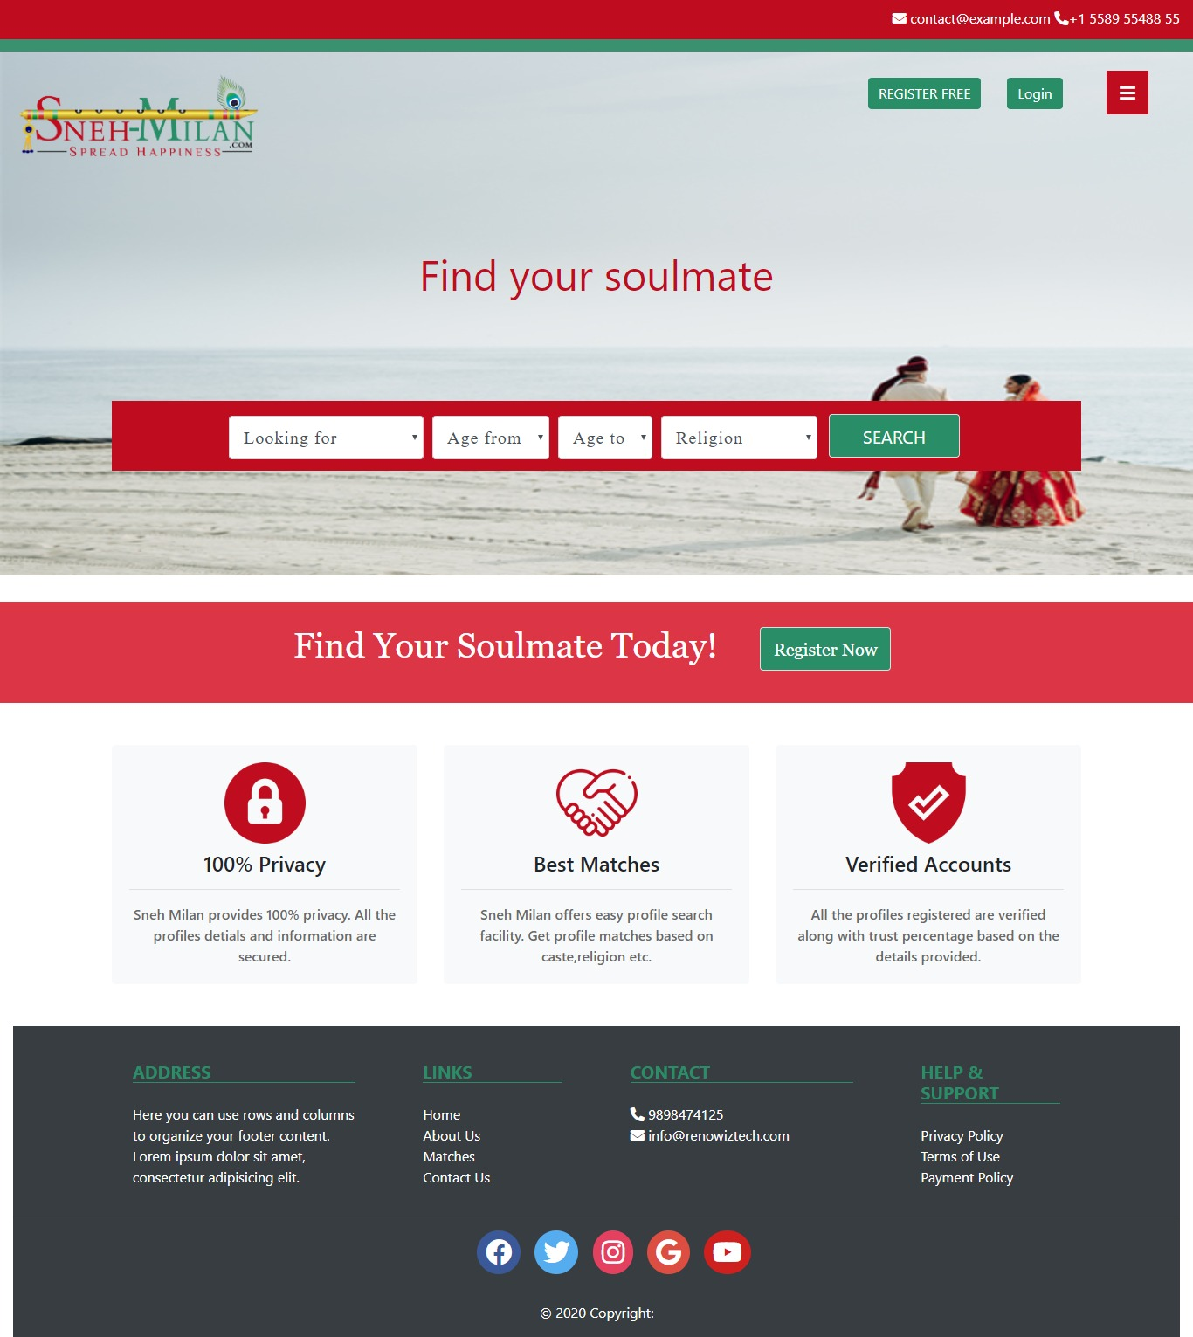
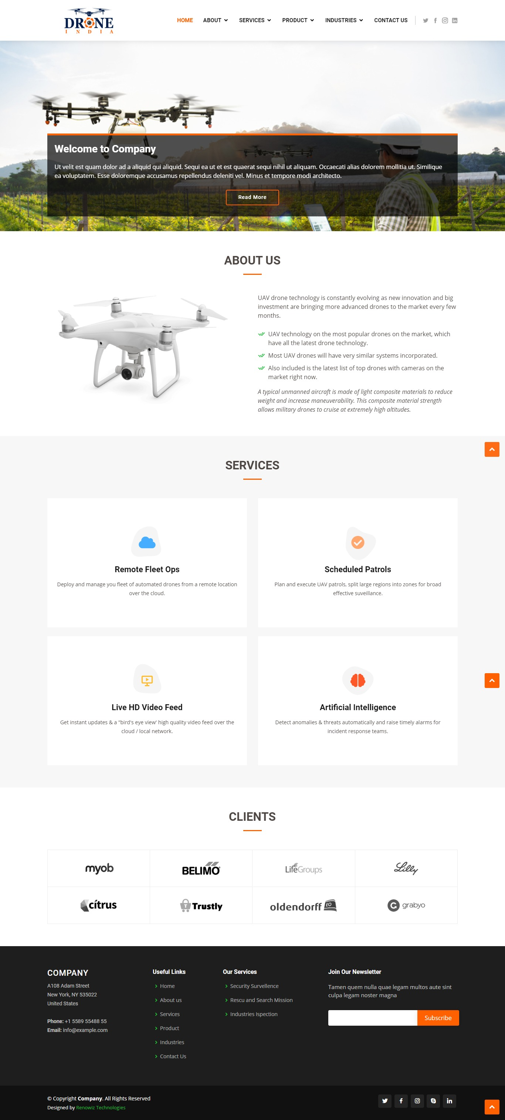
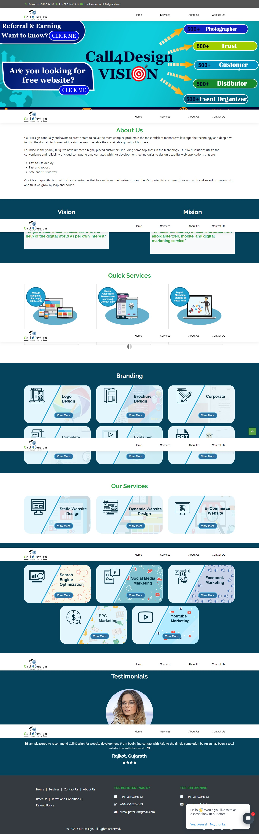
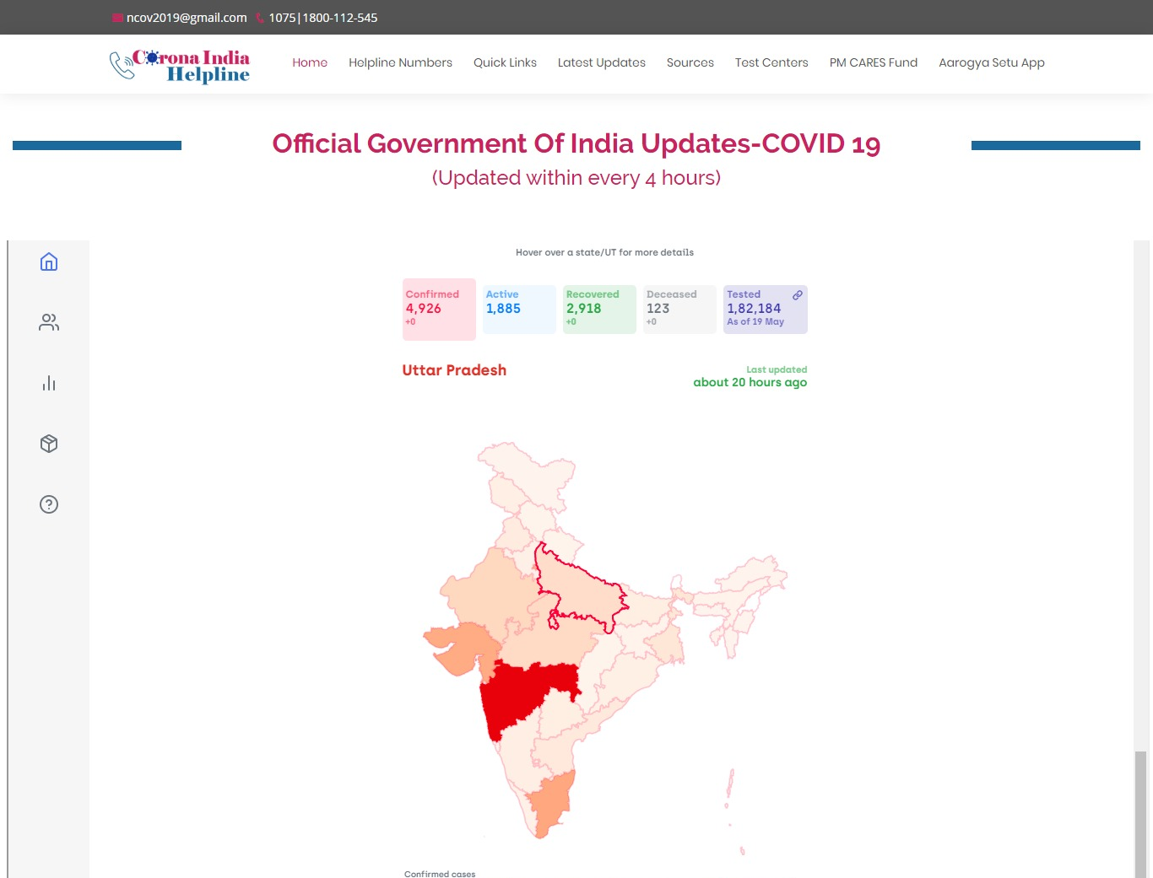

Our Website Portfolio
www.sneh-milan.com/dev/home.html
www.thedroneindia.com/
call4design.com/
Static Website
Dynamic Website
Custom Website
View More
www.coronaindiahelpline.in/
www.renowizlive.com/
www.renowiztech.com
+91 9737378824
info@renowiztech.com
Notes:
Team - team work team share name

Slide 7


Our Portfolio
Explainer Videos
Renowiz Technologies Services
Sneh Milan Matrimonial
www.renowiztech.com
+91 9737378824
info@renowiztech.com

Slide 8


Our Packages
14999/-
20000/-
30000/-
SUPER
EXCLUSIVE
PREMIUM
Logo - 2 option
Business Card - 2 design
Brochure - 1 design
Banner - 2
Website - 10 page
Domain - 1 year validity
Web Hosting - 1 year validity
Website Maintenance - 1year
Intro-Explainer Video
Logo – 4 option
Business Card - 4 design
Brochure - 1 design
Banner - 2
Website - 15 page
Domain - 1 year validity
Web Hosting - 1 year validity
Website Maintenance - 1year
Basic-Explainer Video
Logo – 5 option
Business Card - 4 design
Brochure - 1 design
Banner - 2
Website - 25 page
Domain - 1 year validity
Web Hosting - 1 year validity
Website Maintenance - 1year
Story-Explainer Video
To see more packages
Click here
www.renowiztech.com
+91 9737378824
info@renowiztech.com

